Slide 1
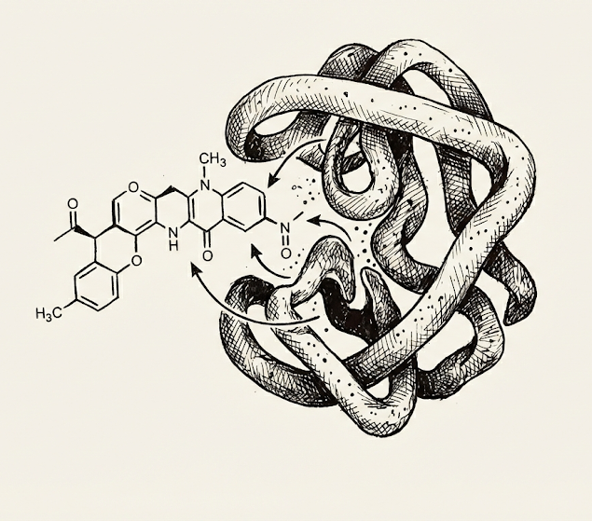
DeepGLSTM
Transformer-Based Protein Encoding and Multi-Head Attention Fusion
Kovvada Dhyana Vardhan (21CS30030) Research for future work, Making Presentation, Writing the Report
Trying out structure based protein embedding models
Tanishq Prasad (21CS30054) Writing the Report, Scripting and Running models on the server, Integration of attention mechanism, Refactoring Presentation
Ayush Sunil Munot (21ME3FP55) Integration of ESM, Integration of Experiments, Made a working demo for the presentation

Slide 2
Overview and Agenda
Solving the drug-target binding prediction problem.
Reviewing previous solutions and their limitations.
Introduction to the novel DeepGLSTM model architecture.
Experimental results, reproduction, and quantitative analysis.
Discussion of potential improvements and future work.

Slide 3
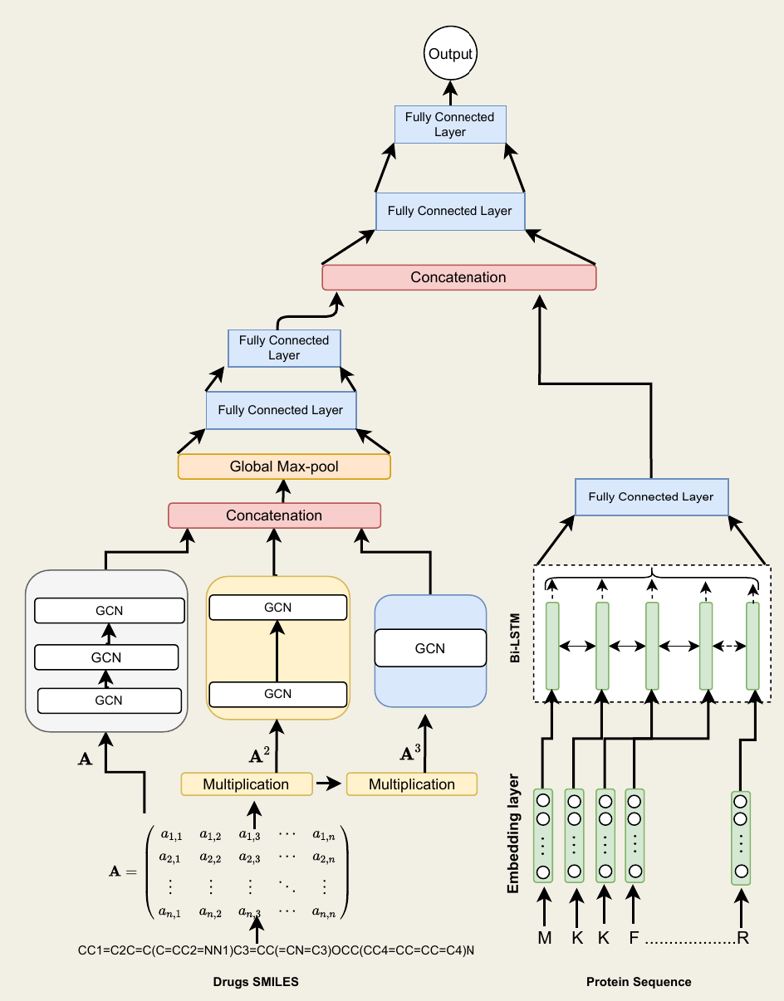
Model architecture of DeepGLSTM

Slide 4
Limitations of existing Model
LSTM struggles to capture long-range dependencies.
Concatenation ignores the dynamic interaction between drug and target protein.
Proteins are taken as sequences which leads to loss of structural information of proteins.
Flattening or pooling operations treat all residues equally, which results in information loss of binding pockets.

Slide 5
Limitations of existing Model
Model assumes all residues contribute equally, ignoring only specific residues are critical.
Drug molecules are represented without explicit 3D information, this might miss important chemical features
The model outputs only scalar affinity value and does not explain which residues or interactions contribute to the binding.
The architecture does not explicitly encode spatial or geometric relationships between residues, limits its ability to model real biochemical interactions.

Slide 6
Proposed Improvements
Replacing standard LSTM protein encoder with a pre-trained ESM-2 transformer. This utilizes ESM-2 to obtain information of structural and biological properties of proteins, which is better than LSTM.
Introduced Multi-Head Attention Module which uses dimensional space features and also utilizes cross-attention alongside unified self attention. With Cross-Attention mathematically mimicking the physical binding process, the model learns how much a drug is ‘attending’ to a specific global properties of target protein structure.

Slide 7
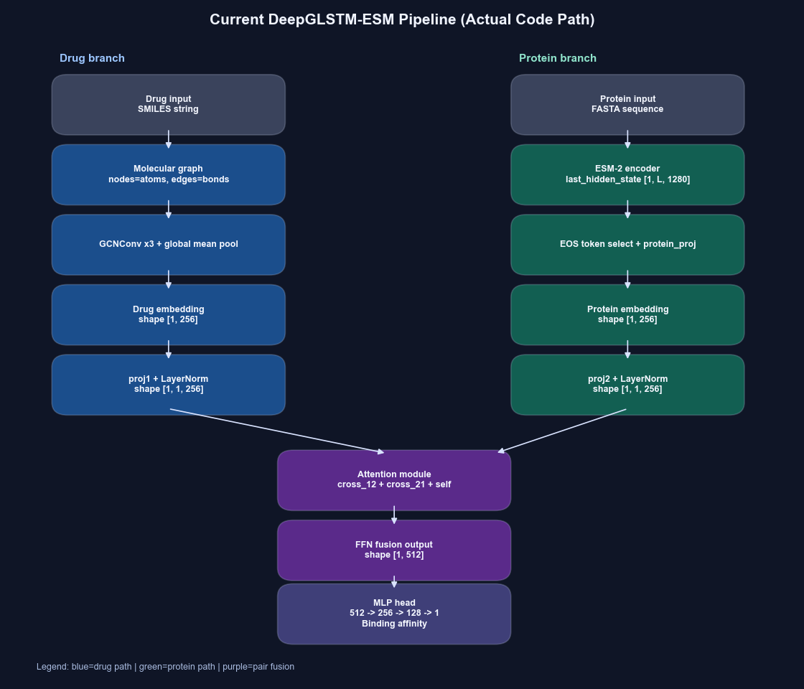
Architecture and Working Demo

Slide 8
FINAL RESULTS WITH PROPOSED IMPROVEMENTS
Dataset | MSE |  |  |  | CI |  |  |  | r_{m}²
 | Paper | Reproduced Results (Baseline) | Reproduced Results with ESM w/o attention (Baseline) | Reproduced Results with ESM with attention (Baseline) | Paper | Reproduced Results (Baseline) | Reproduced Results with ESM w/o attention (Baseline) | Reproduced Results with ESM with attention (Baseline) | Paper | Reproduced Results (Baseline) | Reproduced Results with ESM w/o attention (Baseline) | Reproduced Results with ESM with attention (Baseline)
Davis | 0.232 | 0.56 | 0.55 | 0.47 | 0.895 | 0.75 | 0.77 | 0.82 | 0.680 | 0.3 | 0.32 | 0.41
KIBA | 0.133 | 0.382 | 0.33 | 0.29 | 0.897 | 0.768 | 0.79 | 0.83 | 0.792 | 0.412 | 0.51 | 0.58
Experiments are run on both Davis and Kiba dataset, with subset frac of 0.3, for 60 epochs. Original paper uses 1000 epochs.
MSE: Measures the average squared difference between predicted and original binding affinity values.
Concordance Index (CI): Measures if the rank order of predicted and ground-truth binding affinity score are consistent.
r_{m}²: Evaluates external prediction performance of QSAR(Quantitative Structure-Activity Relationship) models. A model is acceptable if and only if r_{m}²≥ 0.5

Slide 9
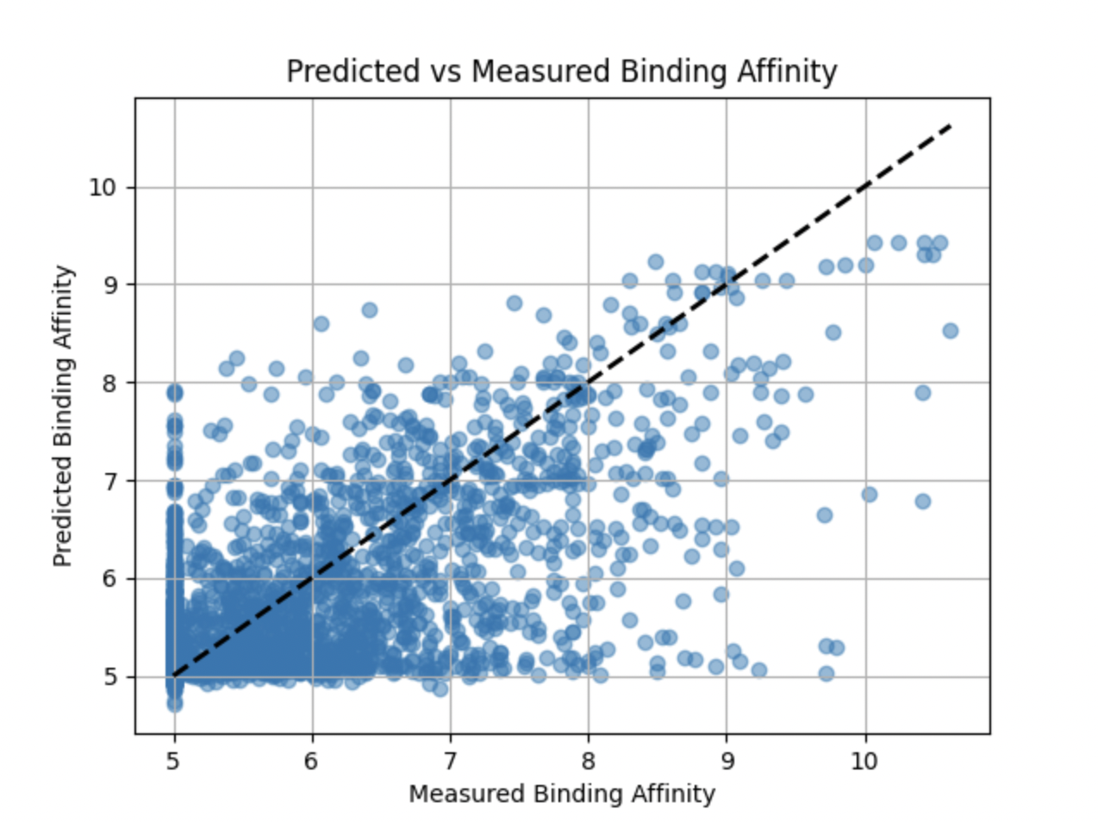
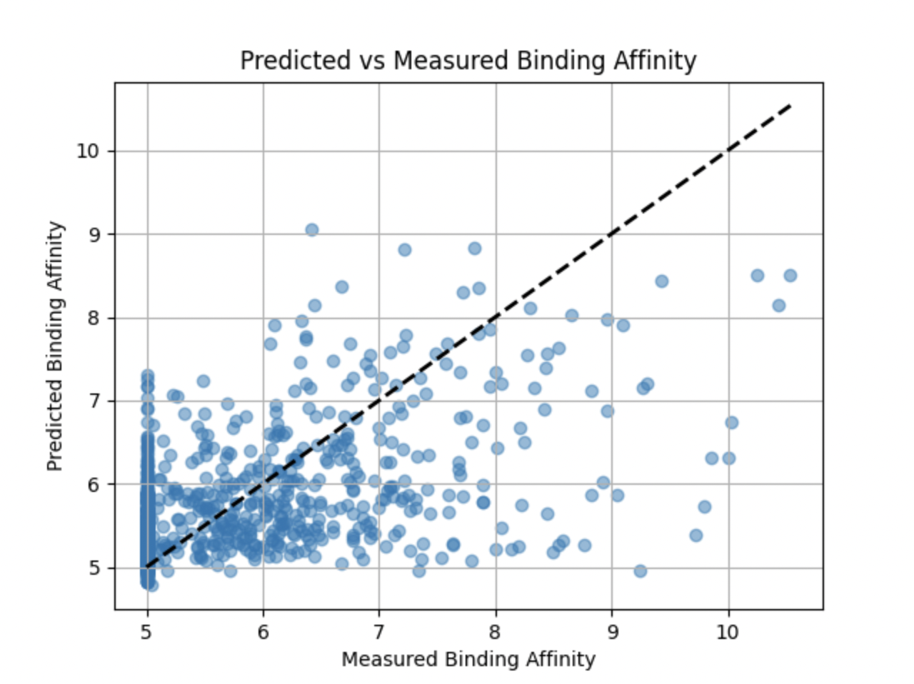
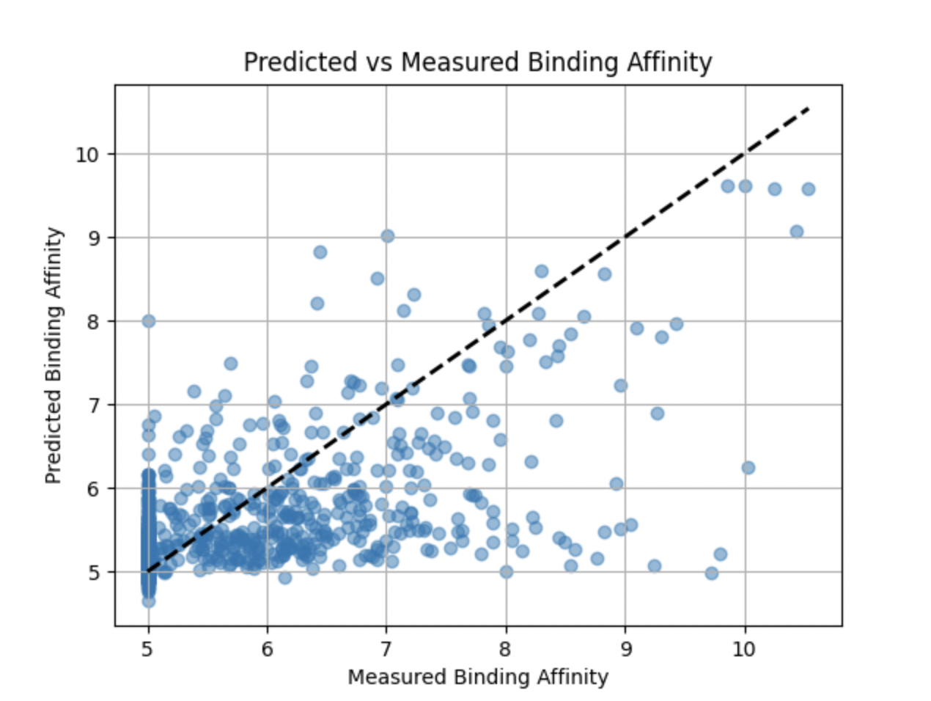
Predicted vs Measure Binding Plots
Predicted vs Measured Binding Affinity (Baseline Reproduced)
Predicted vs Measured Binding Affinity with ESM
Predicted vs Measured Binding Affinity with ESM with attention

Slide 10
Questions?

Slide 11
THANK YOU

Slide 12
Appendix

Slide 13
DeepGLSTM
Better accuracy prediction score using two main functional modules.
SMILES notation is used to represent the drug compound molecules as a graph, using RDKit.
The model uses GCN blocks to capture topological information from drugs with adjacency matrices upto two hop distance, resulting in graph embedding.
Bi-LSTM is used to capture sequential information from protein sequences converting them into protein embeddings.
Followed by concatenation of the embeddings which is then passed through fully connected layers.

Slide 14
Experimental Results
Dataset | MSE |  | CI |  | r^2_m
 | Paper | Reproduced Results | Paper | Reproduced Results | Paper | Reproduced Results
Davis | 0.232 | 0.387 | 0.895 | 0.832 | 0.680 | 0.479
KIBA | 0.133 | 0.382 | 0.897 | 0.768 | 0.792 | 0.412
Metz | 0.294 | 0.41 | 0.810 | 0.767 | 0.640 | 0.516
Robust Ranking Capability: Achieved a strong Concordance Index (CI) of 0.832 on Davis, proving the model correctly distinguishes high vs. low affinity pairs despite limited training data.
Expected Performance Gap: MSE increased (0.387 vs. 0.232) and r_m^2 dropped as a direct result of training on a 30% data subset.
Successful Convergence: The model effectively learned predictive patterns across all metrics (MSE, CI, r_m^2) within just 400 epochs, demonstrating architectural robustness.

Slide 15
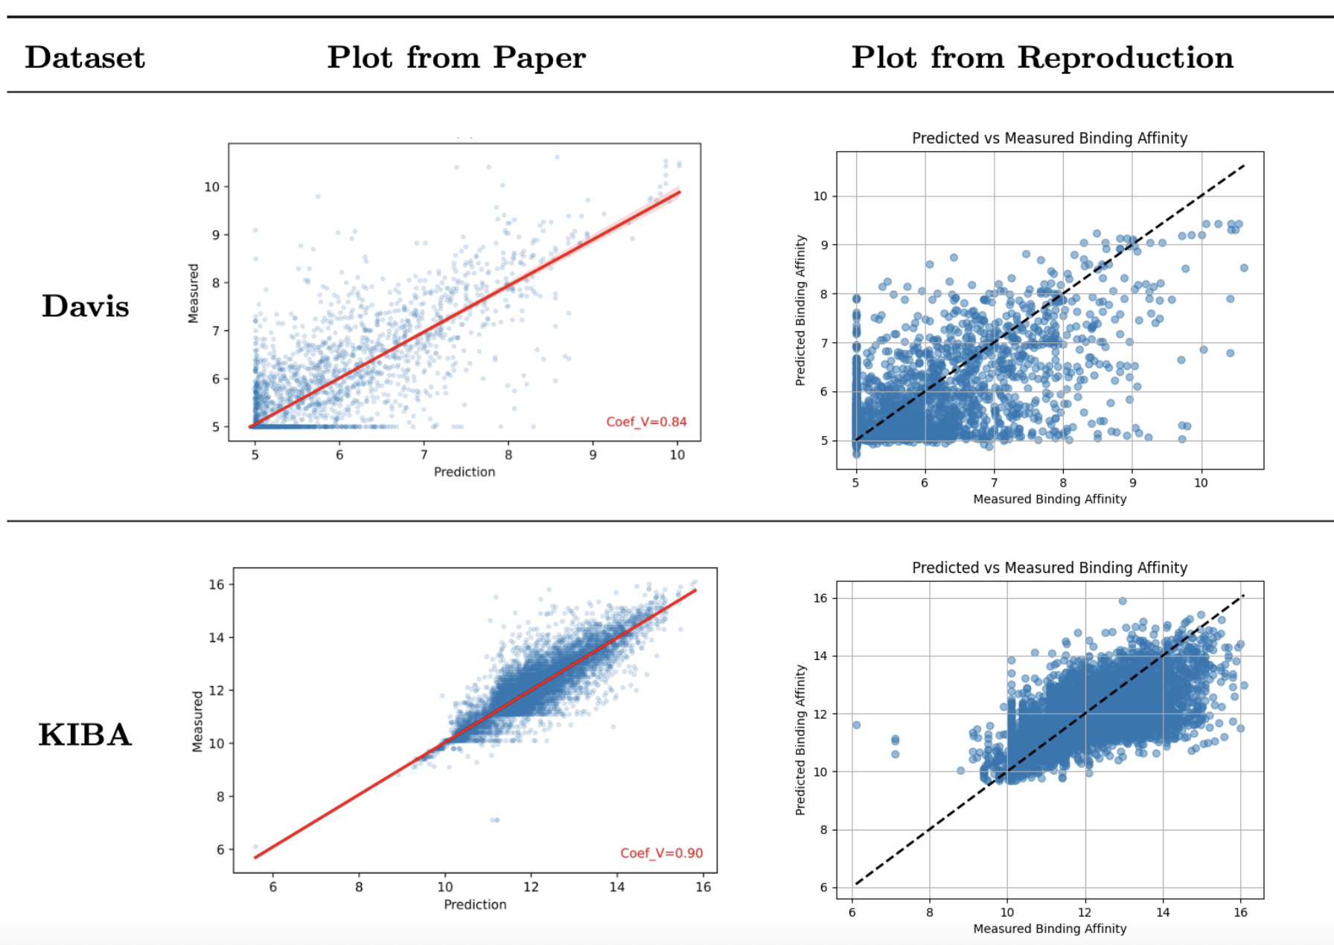
Qualitative Analysis
Correlation Confirmed: Reproduced plots track the diagonal (y=x) effectively, validating that the model learned the fundamental binding physics despite constraints .
Variance vs. Data (Davis): The reproduction shows a wider prediction spread (visual noise) compared to the paper's tight clustering, directly resulting from training on only 30% of the data .
Saturation Effect (KIBA): High-density region shows model slightly under-predicts extreme high-affinity values (top-right), side effect of reducing training from 1000 to 400 epochs.

